Slide 1
Automate your
GRC Busywork
www.sprinto.com

Slide 2
Location
San Francisco, Bangalore & Canada
Team
200 members & growing
Who We Are. SPRINTO
Advisors from
1Password, NSA, Ivanti, Skyflow
Founders
2x SaaS experience
Funding till date
$31.8 Mn

Slide 3
1000+
happy customers: from startups to enterprises

Slide 4
with Sprinto, your compliance program is in good hands

Slide 5
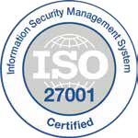
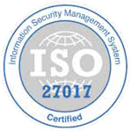
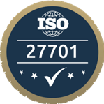
50 compliance frameworks + Custom
framework support
SOC2
Security, Privacy • Global
ISO 27001
Security• Global
PCI DSS
Security • Global
GDPR
Privacy • EU, UK
HIPAA
Privacy • Global
ISO 27017
Security • Global
CCPA
Privacy • California
CSA Star Alliance
Security • US
FedRAMP
Security • US
NIST
Security • US
CMMC
Security • US
HITRUST
Security • Global
ISO 27701
Privacy • Global
PIPEDA
Privacy • Canada
Australian DPA
Privacy • Australia

Slide 6
Build trust
with your customers
without compromising on your agility

Slide 7
sales@sprinto.com
sprinto-com
SprintoHQ

