Slide 1
Smart Industry – Dumb Industry: Sensors in the Field
November 9, 2018
Scott Sullivan, SVP Operations
Notes:
My daughter just had her 28th birthday a few weeks back. I remember with vivid detail the incredible day she came into this world……..Early that morning my wife gave me that look. Being a Marine at the time I was prepared….bags packed and in hallway.
Gas tank filled and car pointing down the driveway and directions typed out (No WAZE back then……). What I was not prepared for was 12 hours of having the blood squeezed out of my hand. The continues trip to the ice machine for ice chips. The
Verbal attacks that I was responsible for this……..;-). When all was done we had a beautiful little girl and my wife stated “Don’t you wish that you could have experienced this?? HELL NO!!!!!!!!!!!
A close friend of mine recently stated that with my background of running Coopers & Lybrands security practice, having sold and delivered large enterprise projects around Cyber Security, Network Security and Data Security that if I got my security
Certifications that I could be a CISO……..I thought about this for about 5 seconds when I remembered the 12 hours of agony, loss of blood in my hands and the verbal insults that I received and commented back to her……HELL NO!!!!

Slide 2
When is the right time for security to get involved in an IoT project?
NOW!!!!!!!!
Notes:
Security Team needs to get involved at the beginning of each IoT project to better understand the Use-case, solution, and how it will be rolled out POC to Pilot to Enterprise. Flush out the architecture at the beginning to keep the security risk at a minimum

Slide 3
“YOU NEED TO SPEAK THE IOT LANGUAGE”
SECURITY FOR THING’S
NOT JUST PEOPLE
Notes:
The job complexity of a CISO or Security Architect has just increased by a factor of 10.
The IT world is clean…tidy… and updated every three years or so……on the other hand the OT world can be gritty with technology approaching 10 to 15 years in age.
A typical Oil Rig has over 40,000 sensors sending more than a Terabyte of data per day.
A typical Refinery has 50% of their meters and sensors in place for more than 10 years.
You now have thousands of machines talking directly to machines with no human intervention…….turning on valves, heating elements, flowing product hundred of miles to then be trucked to a customer.
Who should have access to each and every sensor? Where is this information stored and for how long? How are devices updated with security patches? Should Oil Rigs be sending a Terabyte of data each day to the Cloud…..why?

Slide 4
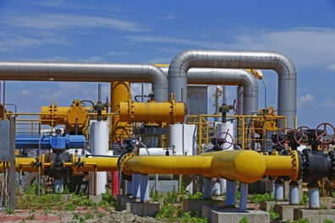

Energy, Retail & Logistics – share a need to move sensors into the field:
As IoT plays an increasing role in the Industrial Space we all witness:
  New data sources, systems and connections to support
  New connections likes of which were not there before
  We need to understand what people are touching and why
  What will be the critical function to a business ROI
  How will security be proactive
  What do we see as a typical IoT process
  When should security be involved in the process (hint…..NOW!!!)
Notes:
Energy, Retail and Logistics all are quickly moving sensors into the Field.
--An old Steam Analog Meter which a person would take daily readings and input this into their ERP system is now Bluetooth enabled and sending data directly to your business applications.
--Refrigeration units in your local grocery store are now smart enough to know when they are sick and schedule a technician to pick-up a new part for replacement.
--A Fuel Truck operator no longer has to drive around their 300 acre site trying to find all of the Forklifts and Cherry-pickers to see if they need to be refueled….she now looks on her iPad which tells her all levels of fuel and exactly where each asset is located.

Slide 5
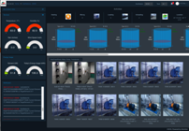
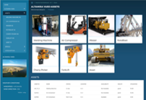

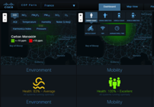
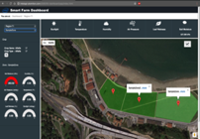
Atomiton – A Global Leader in IIoT
Global Presence
Energy/Oil and Gas
23 countries, 4 continents
80+ deployments
400,000+ devices live in the field
98 million lives impacted
Utilities
Copenhagen
“Bringing Collective Intelligence
to IIoT Makes Devices Compute”
Forbes Magazine , June 2018
“Top 10 Hot IoT Startups to Watch”
Network World, May 2018
“20 Most Promising IoT Solution Providers”
CIO Review 2018
A 2018 “top disruptive influence in tech”
CFO Magazine 2017
Hamburg
Trencin
Schenectady
Bucharest
Dubrovnik
Osaka
Kansas City
Jaipur
Phoenix
Savannah
Dubai
Bangalore
Vijayawada
Altamira
Smart Cities
Mumbai
Chemical Manufacturing
Adelaide
Notes:
We make software that makes industrial operations more efficient by ingesting and analyzing data in real time, and take actions at the pace of operations.

Slide 6



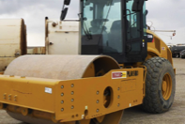


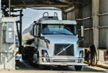

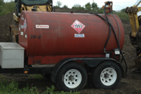



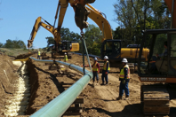
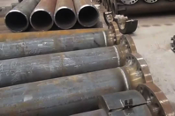






Primary Verticals & Use Cases
Oil & Gas
Utilities
Process Manufacturing
Industrial Construction
(EPC)
Smart City
Energy Optimization: reduce energy costs by predictive peak shaving/shifting, waste reduction and predictive responses
Steam Optimization: reduce steam costs by predicting demand, dynamic generation and sourcing decisions
Asset Productivity:
location, health, availability of assets to support project productivity
Smart Parking
Smart Lighting
Loading Optimization: increase loading throughput and reduce wait-time by using dynamic algorithms and queue prediction
Asset intelligence: monitor and detect health issues and incidences of remote equipment at remote substations, compressor and pump stations
Smart Fuel: predictive management of fuels and gases to ensure project continuity
Waste Management
Smart Transit
Pipeline Integrity: monitor and detect remote pipeline incidences such as leak and vandalism using AI
Construction Surveillance: monitor and detect compliance violations, theft, and vandalism at construction sites using AI
Smart Material: tracking material throughout supply chain
Traffic
Safety & Security
Smart Activities: monitor the progress and quality of key activities (e.g. welding, spooling) to ensure project on-time
Environment Monitoring
Digital Metering: digitize and automate remote and on-site meter reading using artificial intelligence
Safety Monitoring: monitor and recognize unsafe operational activities by personnel using AI
Crowd Monitoring
Atomiton Stack

Slide 7

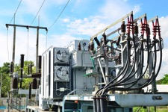
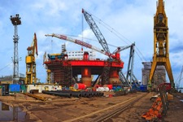
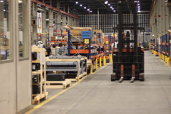
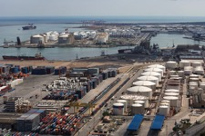
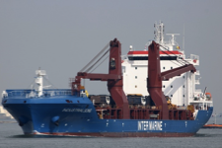
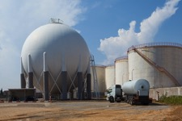
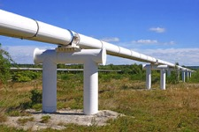
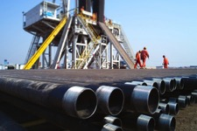

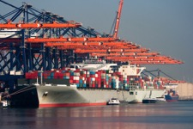
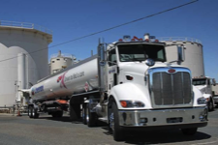








New data Sources, Systems and Connections to support and secure
Industrial
Plants
Remote Infrastructure
Project Sites
Factory & Facilities
Ports & Terminals
Transportation Vessels
Communicating with all industrial devices
Connected to sensors/devices
Connected to fixed machines
Connected to Moving Assets
Connected to Vehicles

Slide 8
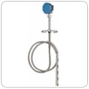





Logical Architecture for A Digital Terminal
Operator UI
Query Engine
Energy Optimization
Loading/Unloading Scheduling
End-to-end Product Transparency
...
Energy Optimization Models
Scheduling Models
Inventory Visibility Models
Schedule Policies
Analytics & Prediction Models
Cooling Profile
Heating Profile
Mixing Profile
Energy Profile
Energy Prediction
Process Policies
Activity & Process Models
Tank Heating
Tank Mixing
Pipe Heating
Loading
Unloading
Subscriptions
Reporting Queries
Asset & Product Models
Product
Boiler
Pump
Motor
Valve
Rail Car
Vessel
Controls
Heat Trace
Steam
Monitoring Queries
Infrastructure Models
Management Queries
Loading Station
Tank
Pipeline
Substation
Transformer
Sensors & Devices
Valves and Pipes
Tanks and Data
IT Systems

Slide 9






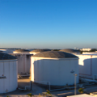


The Chasm Remains between Field Operations and Business Intelligence
Information-Driven
ERP
Supply Chain
Offline Analytics
Logistics
Commercial
Reactive Operations
HMI
People-Driven
SCADA, Historian
PLCs
Flow-Driven
Notes:
Process, Equipment, Infrastructure, Sensors, Devices, Supply Activities

Slide 10
















Deployment Architecture
Ethernet
Enterprise Systems
Database (time series)
Database (structured)
A-Stack
(Plant Applications)
Plant Operator Center
Structured Databases
Maintain both time series and structured data
A-Stack
(Enterprise Applications)
Firewall
Digital Service Grid
IIoT applications can be aggregated at enterprise level
Integrated architecture between IT and OT
Full-stack edge computing
Inline optimization, real-time
Multiple nodes, single pane of glass
Neuron Hub (s)
(A-Stack)
IP (MQTT, TQL/TCP, …)
IP (MQTT, TQL/TCP, …)
MODBUS
Remote Station
Remote Station
Remote Stations
Neuron
(A-Stack)
PLC/RTU
Engineering Client
Neuron
(A-Stack)
PLC/RTU
Relay
Voltage sensor
Current sensor
Pump
Valve
Pressure, level Sensors
Additional various sensors

Slide 11
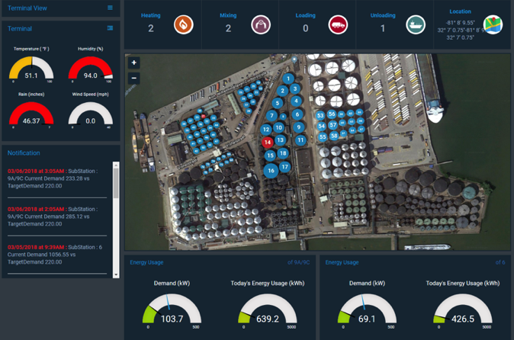
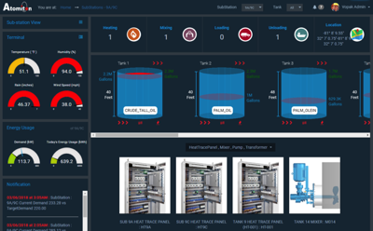
Digital Terminal- Royal Vopak
Notes:
Real Life example. Royal Vopak which owns 67 Tank Terminals with over 13,000 tanks worldwide wanted to save on Total Energy and Peak Energy. To accomplish this task we needed to better understand each and every asset that was utilizing
Energy, at what rate, when, and could the process be changed or altered. So each device needed to be enhanced with different sensors now connected to Edge devices in many different ways……Direct connections, Bluetooth, Wifi, Ziggby, Lorra,
Ethernet, RS232, etc…… How do you secure this type of environment?? Who needs to have access to each asset, device and system on a daily basis to get their job done. How do you upgrade and update these systems.
This is a single Tank Terminal for one of our customers.
---How many sensors do you think it takes to digitize this site? One thousand?, Five Thousand? Twenty Thousand?...........
Well…….Each tank has 6 temperature sensors, three level sensors, vibrations sensors, leak detection sensors, video cameras,
-----Each motor has a temperature sensor, vibration sensor and amperage and voltage sensor.

Slide 12
We need to understand what people are touching and
Why they need to?
Who can update and replace connected hardware within field?
Now that we have automated the Loading & Unloading of products…..who controls this?
When that Grocery Store Freezer starts acting up….who informs the technician, store manager, parts warehouse?
How are operation personnel being informed about status and issues…..Emails, iPad, Phone, Mobile app…..and how do you secure these.
Who should have access to historical data and why?
Is Role Based security going to work in an IoT world?

Slide 13
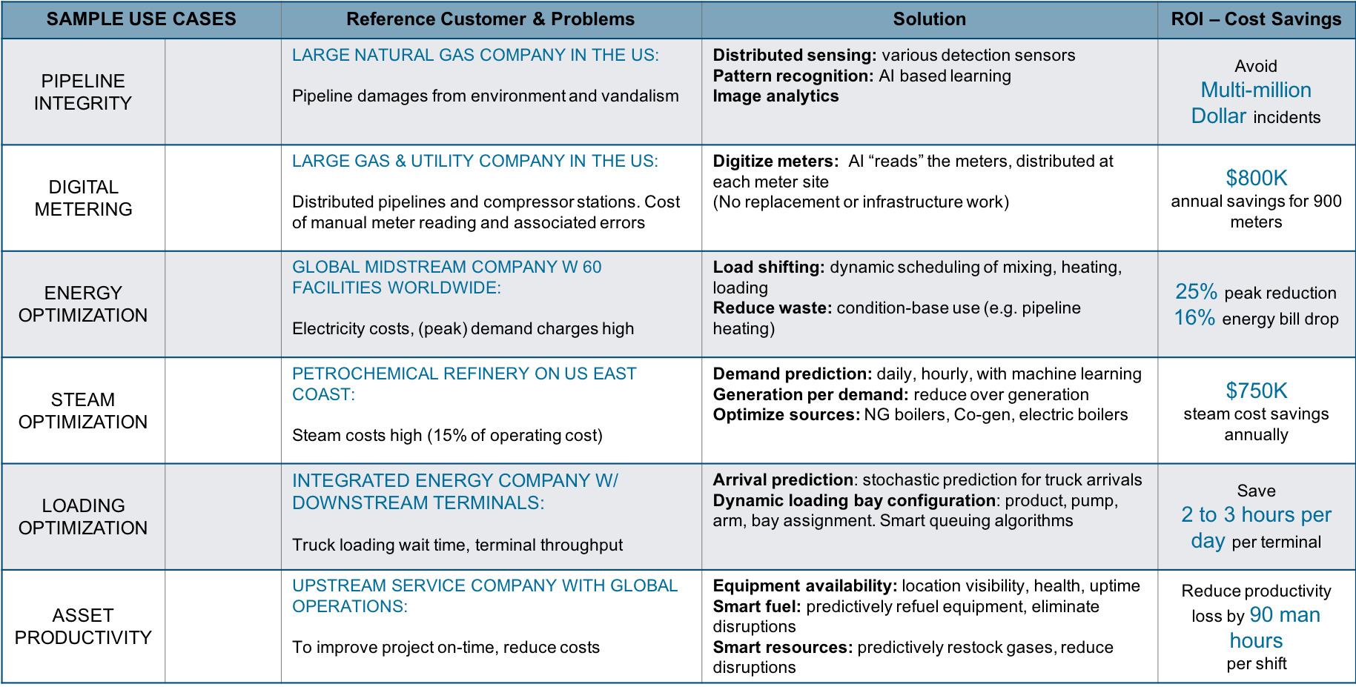
We must anticipate what will be a Fad and what’s going to Stick as a critical feature to the business ROI
Notes:
Every opportunity that we have done has a real ROI tied to it, and to the contract. The days of rolling out solutions without an ROI have passed……
We see about 60 to 70% of our engagements being driven by the CIO’s office. She sees IoT as a way to drive down costs, increase visibility/safety, and be the catalyst between IT and OT.
These CIO’s will fund the initial POC and Pilots and then do a hand-off to Operations to move into the enterprise.
Every opportunity that we have faced in the Industrial market has demanded that a real Return-on-Investment before any funding is given. Every security expert needs to be involved at the POC and Pilot stage to help with
The security architecture that will be required to move an IoT solution to the enterprise.

Slide 14
How can Security be proactive?
Engage IoT Project Managers Early & Often
Have input on Reference Architecture for IoT
  Do you really need to store a Petabyte of temperature data in the cloud for 5 years????
  How are we going to update all of our Edge devices?
  How do we secure the new 5,000+ sensors per site?
  Is Role Based Access applicable to OT?
Better understand the Security of Things and how it relates to personnel.
Use POC’s and Pilots as miniature use-cases that will scale to an enterprise rollout.
How will OT data be communicated to your corporate business logic, and how will your business applications push data back to the OT platforms and systems.

Slide 15
  What do we see as a typical IoT process?
OLD WAY……..
  Operations gives IT a list of operational problems to digest
    IT dusts off the “Operators Guide to Tank Terminal” book and tries to figure out what terms like “Tank-Gager costs to high”, “Need to know when the COFC arrives”, “The Pig keeps getting stuck”……
  IT sends a team down to OT land…..change of clothes required + Hardhat, Florescent Vest, Goggles added, as well as having to take 30 Question Safety test.
  Data is collected around ”operational problems” (i.e., can tank fluid levels be monitored remotely and how?)
  IT goes back to cubical and starts googling “Tank Fluid Levels” and comes up with a short-list of 30 potential vendors and solutions.
    Google “Pig”…..
      Google “COFC”……..(did you mean Cough??)
Notes:
COFC (Container On (Rail) Flat Car)

Slide 16
  What do we see as a typical IoT process?.....
BETTER WAY…..
  IT heads down to OT land and sees exactly what challenges they are facing on a daily basis. Collect as much data around process, procedures and challenges (Environmental, Mechanical, Complexity, Personnel, etc.…).
  IT comes back to HQ and forms a team consisting of at least the following personnel: Security (Data and Physical), Safety, Procurement, Network Architects, and Operations. IT reviews vendor and technology requirements (each use-case will require different hardware, software, models, network connections, data repositories, etc.….)
  Team decides on POC/Pilot criteria and scope. Selects vendors. Works on how IoT architecture will fit into current corporate architecture. Works on ROI numbers and how to measure success.
  Selects vendors, solutions and products to achieve success criteria.
  Manages POC/Pilot to success.
  Works on how to extend solution to Enterprise…….
Notes:
COFC (Container On (Rail) Flat Car)

Slide 17
Scott Sullivan, SVP Atomiton ssullivan@atomiton.com
Thank You

