Slide 1
The ERA of API in the World of IoT
Jing Zhang-Lee
November, 2015

Slide 2
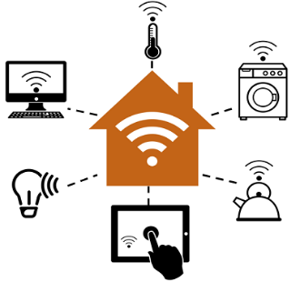
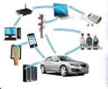
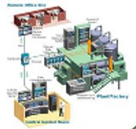
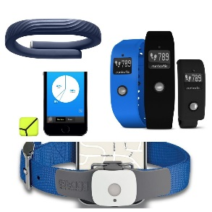
API: The Nerve of Internet of Things
Smart Home
Healthcare
API
API
API
Services
API
Network
Transportation
Industrial
API
API
Wearable
Surveillance

Slide 3
Taste of IoT APIs Connect devices and cloud/web-based services
Evrythng
Fitbit
Grove
Streams
Digital identity & profile for physical object
Make products smart, interactive & traceable
Crypto-secure API tokens
Wireless wearable sensors
Health tracking and trending
OAuth2 for API authentication & user authorization
Environmental monitoring sensor technology
Data stream analytics
RESTful API
Zatar
Xively
Thing
Speak
IaaS detects and connects devices to internet
Enable social media functions on IoT devices
REST and JSON-based API
PaaS integrates physical devices with business systems to gain business insights
RESTful API
Open data platform for IoT data collection, processing and analysis
Open API
Notes:
https://blog.profitbricks.com/top-49-tools-internet-of-things/
https://www.mulesoft.com/infographics/api/internet-things

Slide 4
A Paradigm Shift: API-Centric Organization
Governance
API Lifecycle Mgmt
Cloud Integration
Activity Analytics
Developer Experience
Multi-channel Delivery
Secure Services
SLA & Usage Throttling

Slide 5
Enabling API-Centric: Processes & Tools
API Curate
DevOp
API Gateway
Developer Portal
Integration Service
Secure Testing
Agility, Responsiveness & Convenience

Slide 6
Top 5 API Security Considerations
Design Pattern
API design patterns
Security reference architecture & design patterns
Access Control
Authentication & granular authorization
Monitoring
API access request logging
Access attempt monitoring for brute force & lateral attacks
Adaptive access control
Secure Coding
Input validation & output encoding
Content filtering & exception handling
Data sanitization
Access policy governance
Session Management
Session identifiers protection
Session lifecycle – instantiation, usage, timeout, etc.
Secure token service
Analytics & actions

Slide 7
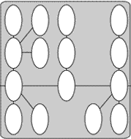
API Security Model At a Glance
Web Client
Mobile Client
Developer
API Gateway
API creation, virtualization & adminitration API firewall SLA & Usage monitoring Secure session management
Adaptive Access
Behavior analysis Risk profiling
Monitoring
Activity logging Monitoring alerts
Access Management
Authentication Authorization Access Policy Mgmt
Intelligence
Access intelligence Threat intelligence
Integration Service
API Orchestration Data transformation
Services

